Slide 1
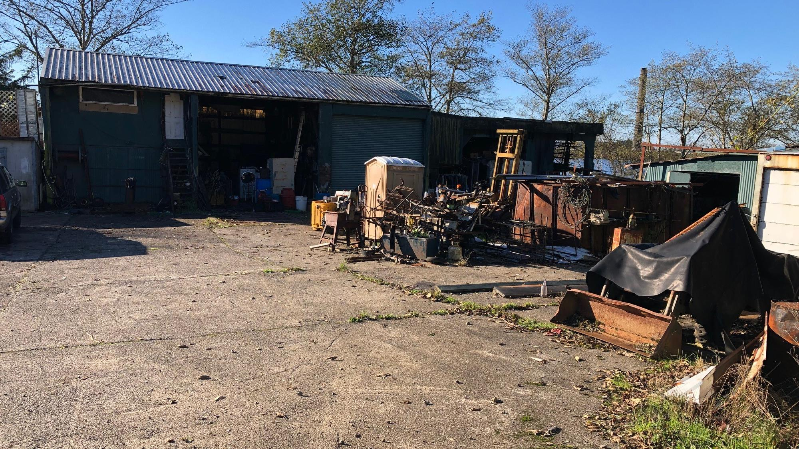
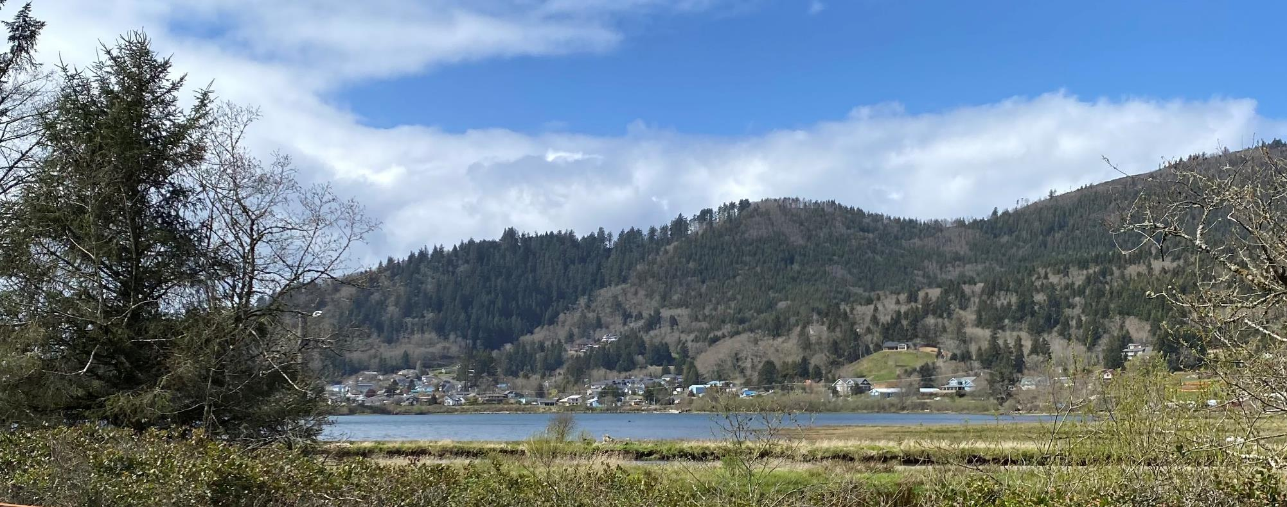
ColPac EPA Brownfield Revolving Loan Fund (RLF) Summary
Presented by: ColPac & CHA Consulting
November 7 and 8, 2023

Slide 2
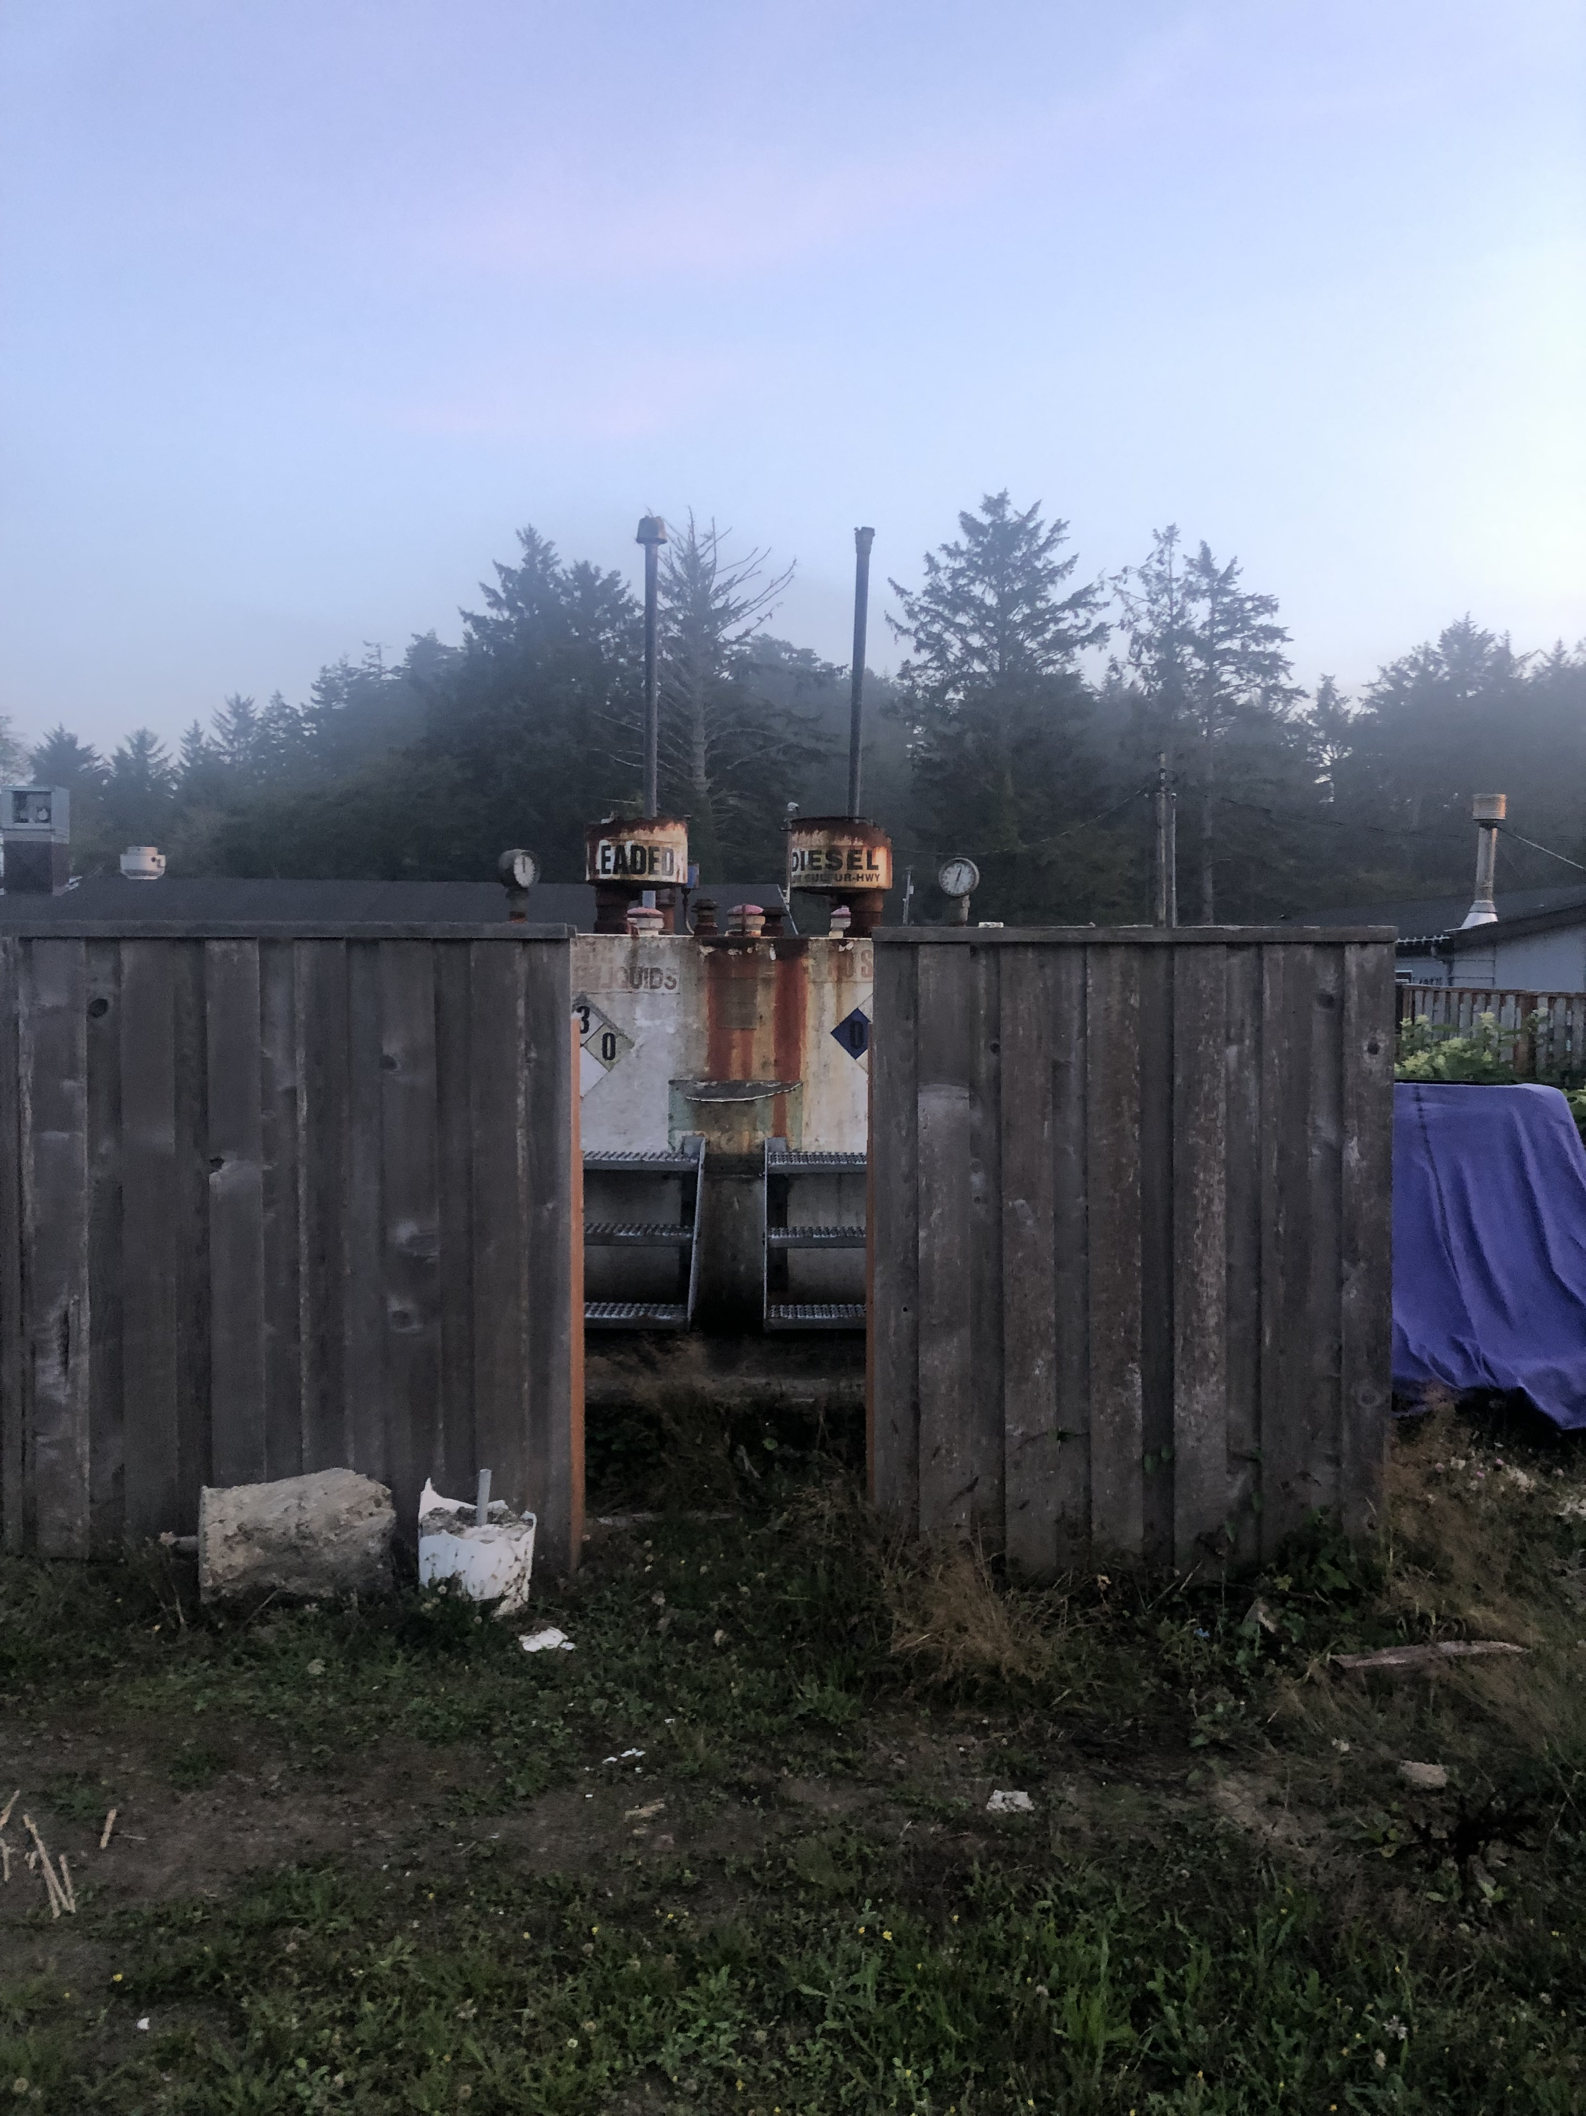
RLF Presentation Summary
Introductions
Sarah Lu Heath; ColPac
Keith Ziobron, PE; CHA Consulting
All
Background & Funding Opportunity Review
ColPac’s Brownfield Program
Accessing the Funding
Case Studies
Questions/Contacts
2

Slide 3
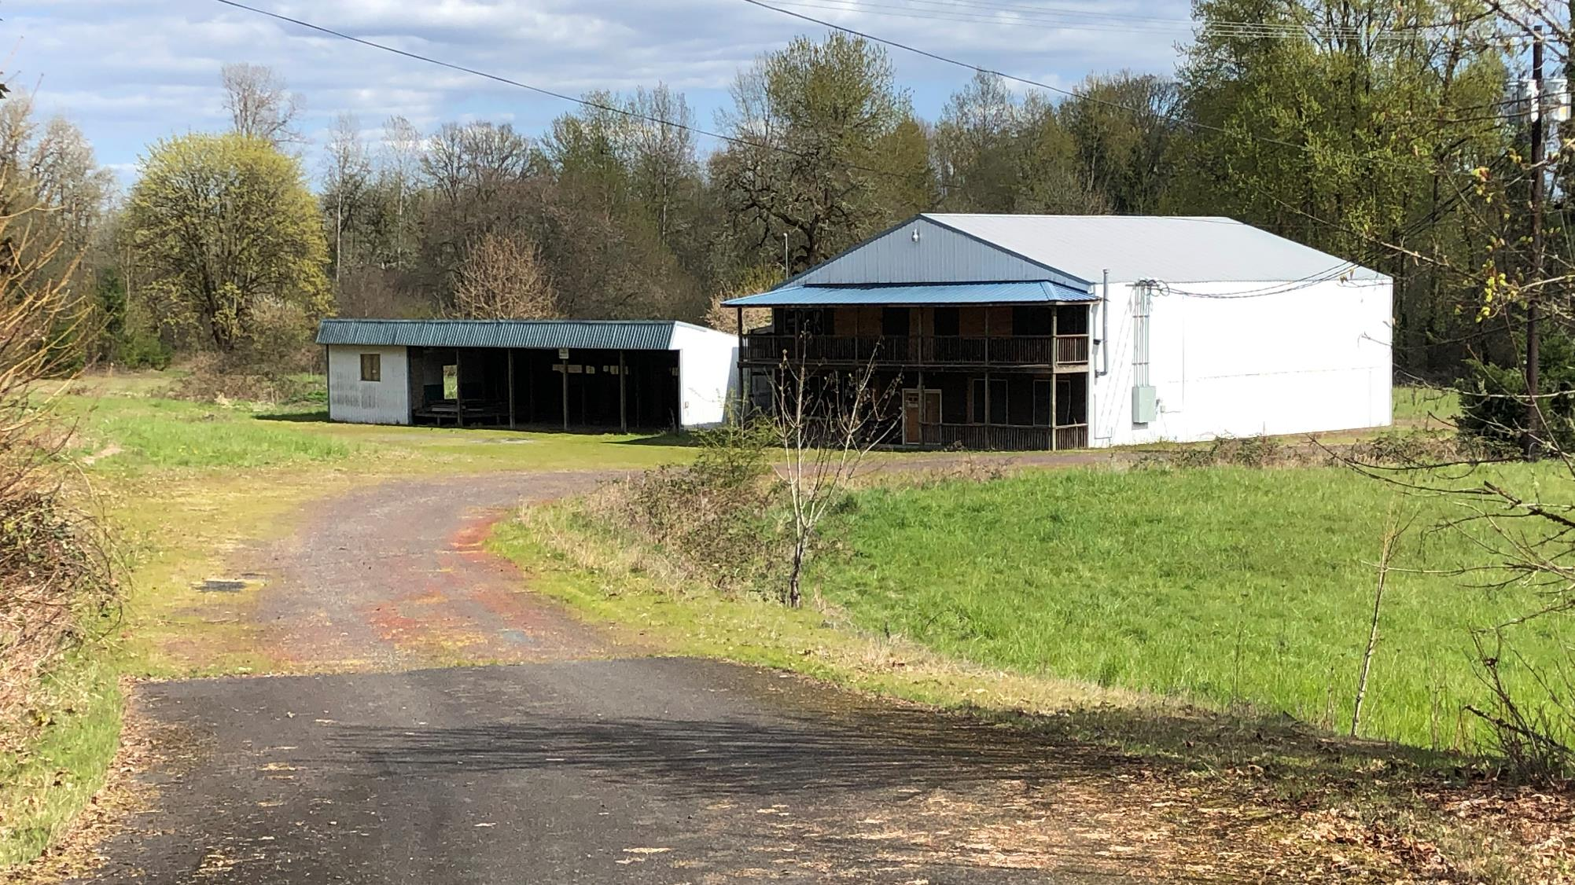
Background & Funding Opportunity Review

Slide 4
Teamwork & Leveraging

Slide 5
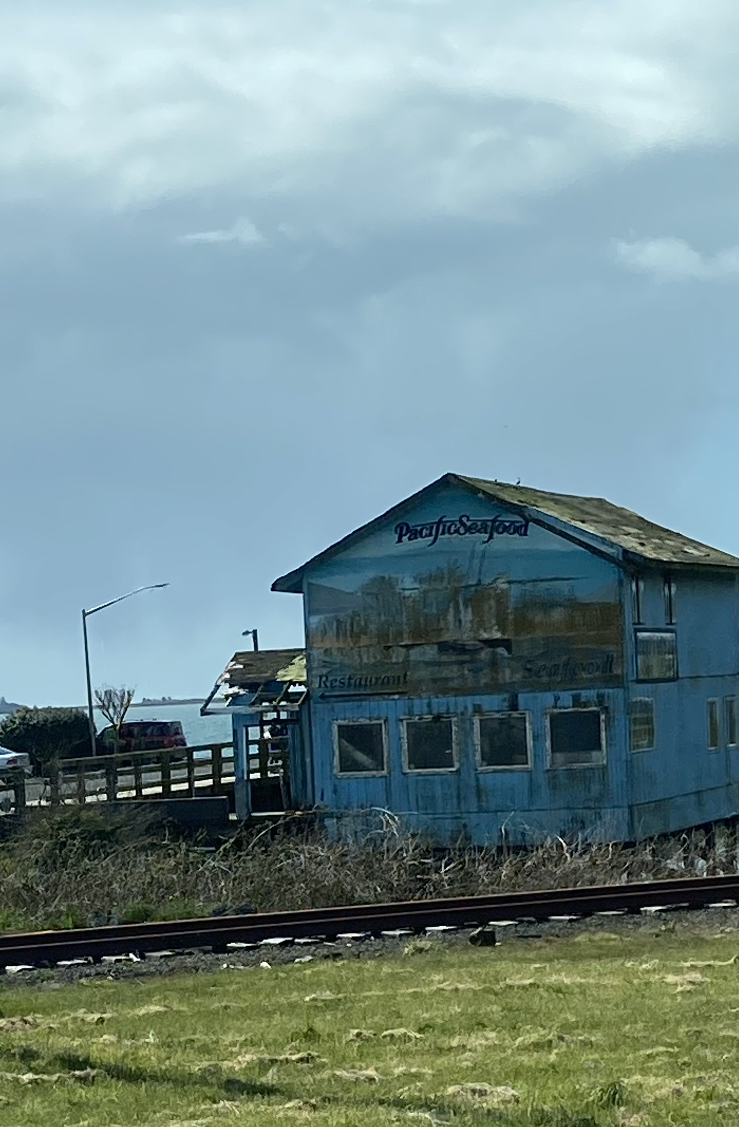
Other EPA Grant Opportunities
EPA Assessment Grants
$500,000 - $1,000,000
Brownfields inventory - focus on developable sites
Community outreach and engagement - paramount to brownfields success
Phase I and II Environmental Assessments
Cleanup and reuse planning
EPA Brownfield Cleanup Grant
Up to $2 million per site
Local governments, Economic Development agencies or non-profits (match TBD)
Grantee must own site at time of application & Eligibility must be vetted
Multipurpose Grant – Even Fiscal Year
Up to $1,00,000 for assessment and cleanup
The US Conference of Mayors has identified lack of cleanup funding as the #1 impediment to Brownfields redevelopment
5

Slide 6
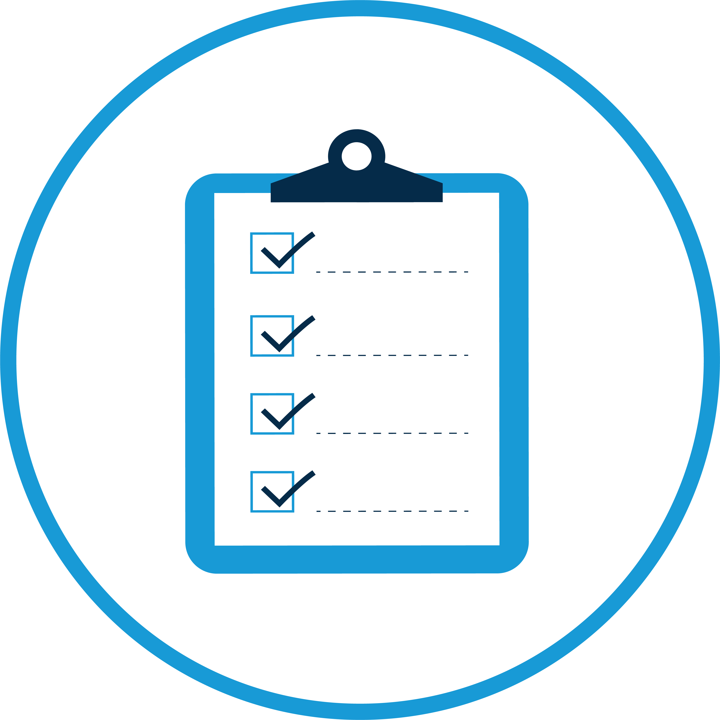
Brownfield Revolving Loan Fund (RLF) Grant – Odd Fiscal Year
Up to $1 million annually for cleanup
Funded activities include:
Low-to-no-interest loans for public and private sector
Sub-grants for non-profits for cleanup
Supplemental Funds can be requested annually
Community outreach and engagement - paramount to brownfields success
Leverage Business Oregon Programs
6

Slide 7
EPA Program Benefits - By the Numbers
Summary of EPA Brownfields Program Accomplishments
Performance Measure | Cumulative Program Accomplishments
Properties assessed | ~30,000
Jobs leveraged | ~150,000
Dollars leveraged | ~$27 billion
Acres made ready for anticipated reuse | >77,000
7

Slide 8
Tillamook County EPA Project Officers
RLF Project Officers
Sarah Frederick
p. 206.553.1601
e. frederick.sarah@epa.gov
Margaret Olson
p. 503.326.5874
e. olson.margaret@epa.gov
8

Slide 9
Business Oregon Brownfield Grant & Loan Opportunities
Oregon Brownfields Redevelopment Fund - a direct loan and grant financing program to assist property owners to conduct environmental actions and assessment through cleanup on brownfields.
Oregon Brownfields Cleanup Fund - a low-interest loan and grant financing option for cleanup projects on properties impacted by the existence of hazardous substances and for which cleanup is necessary in order for development or redevelopment can occur.
Integrated Planning Grants
9

Slide 10
Oregon Brownfield Resources
Business Oregon Contact
Karen Homolac, Brownfield Specialist
Assessment, Cleanup & RLF Grants
p. 503.986.0191
e. karen.homolac@state.or.us
Oregon DEQ Regional Contact
Kara Master, Brownfields Coordinator/Project Manager
DEQ NWR Cleanup Program
p. 503.229.5585 | m. 503.686.3903
e. kara.e.master@deq.oregon.gov
10

Slide 11
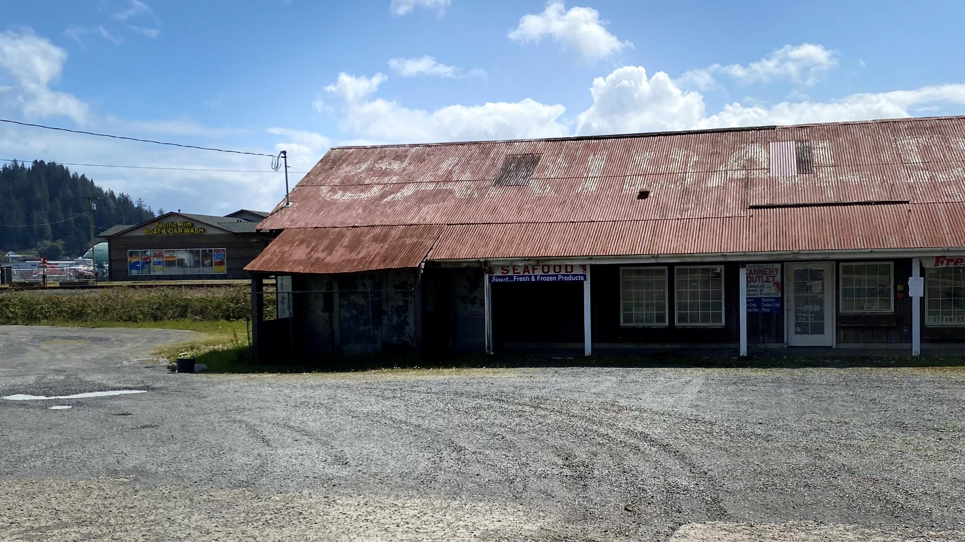
ColPac’s Brownfield Program Goals

Slide 12
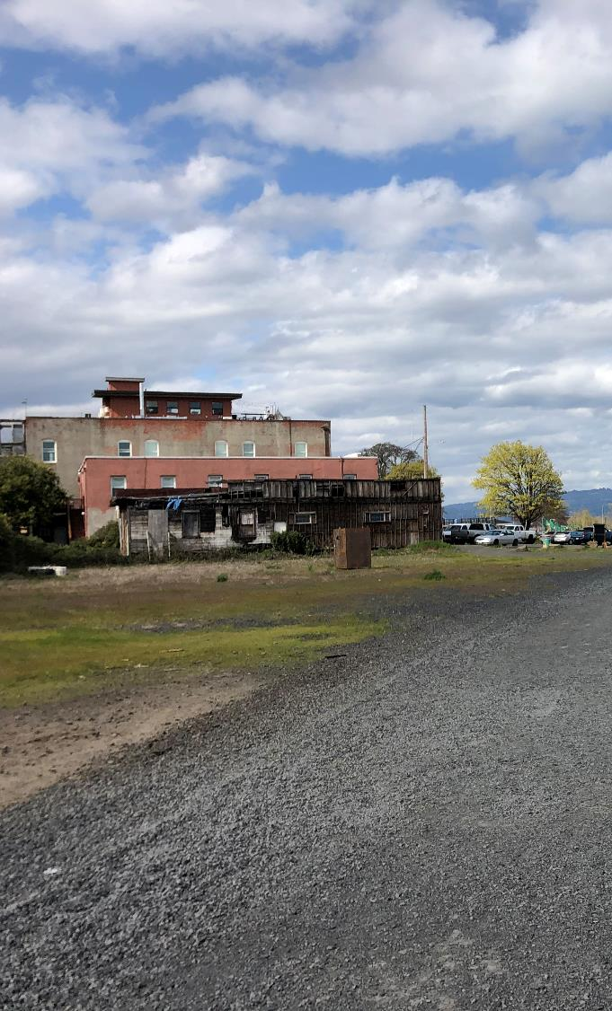
Background/Purpose
In May 2022, the Columbia Pacific Economic Development District (ColPac) was awarded a $1 M Environmental Protection Agency (EPA) Brownfields Revolving Loan Fund (RLF) Grant.
The grant will be used to capitalize a revolving loan fund from which the ColPac provide loans (private developers) and subgrants (municipalities & non-profits) to support Brownfield cleanup activities.
RLF will be available through ColPac’s full service area, area: Columbia, Clatsop, and Tillamook Counties and western Washington County.
The US Conference of Mayors has identified lack of cleanup funding as the #1 impediment to Brownfields redevelopment
12

Slide 13
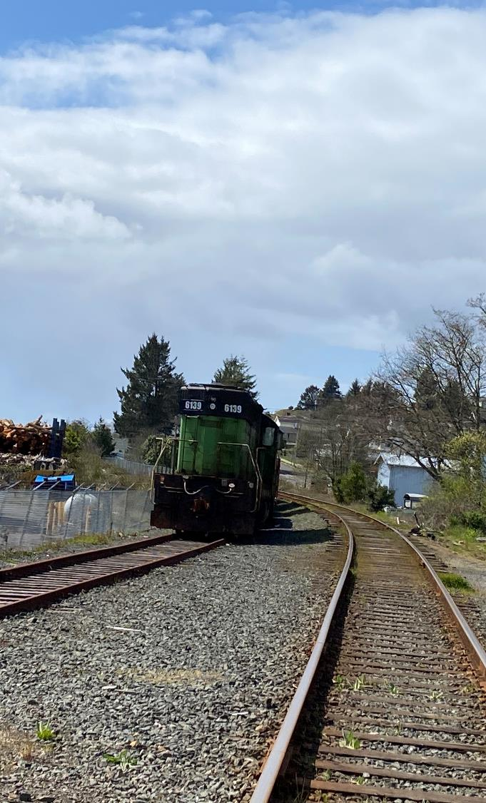
ColPac’s Brownfield Program Goals
Provide Expanded Equitable Housing Opportunities
Return Vacant or Underutilized Properties into Productive Reuse
Protect Human Health and the Environment
Economic Development
Spur Job Growth
Eliminate Blight
Leverage Additional Regional and State Resources
Tillamook County Community-wide Assessment Grant
Clatsop County Community-wide Assessment Grant
Business Oregon Brownfields Properties Revitalization Fund
13

Slide 14
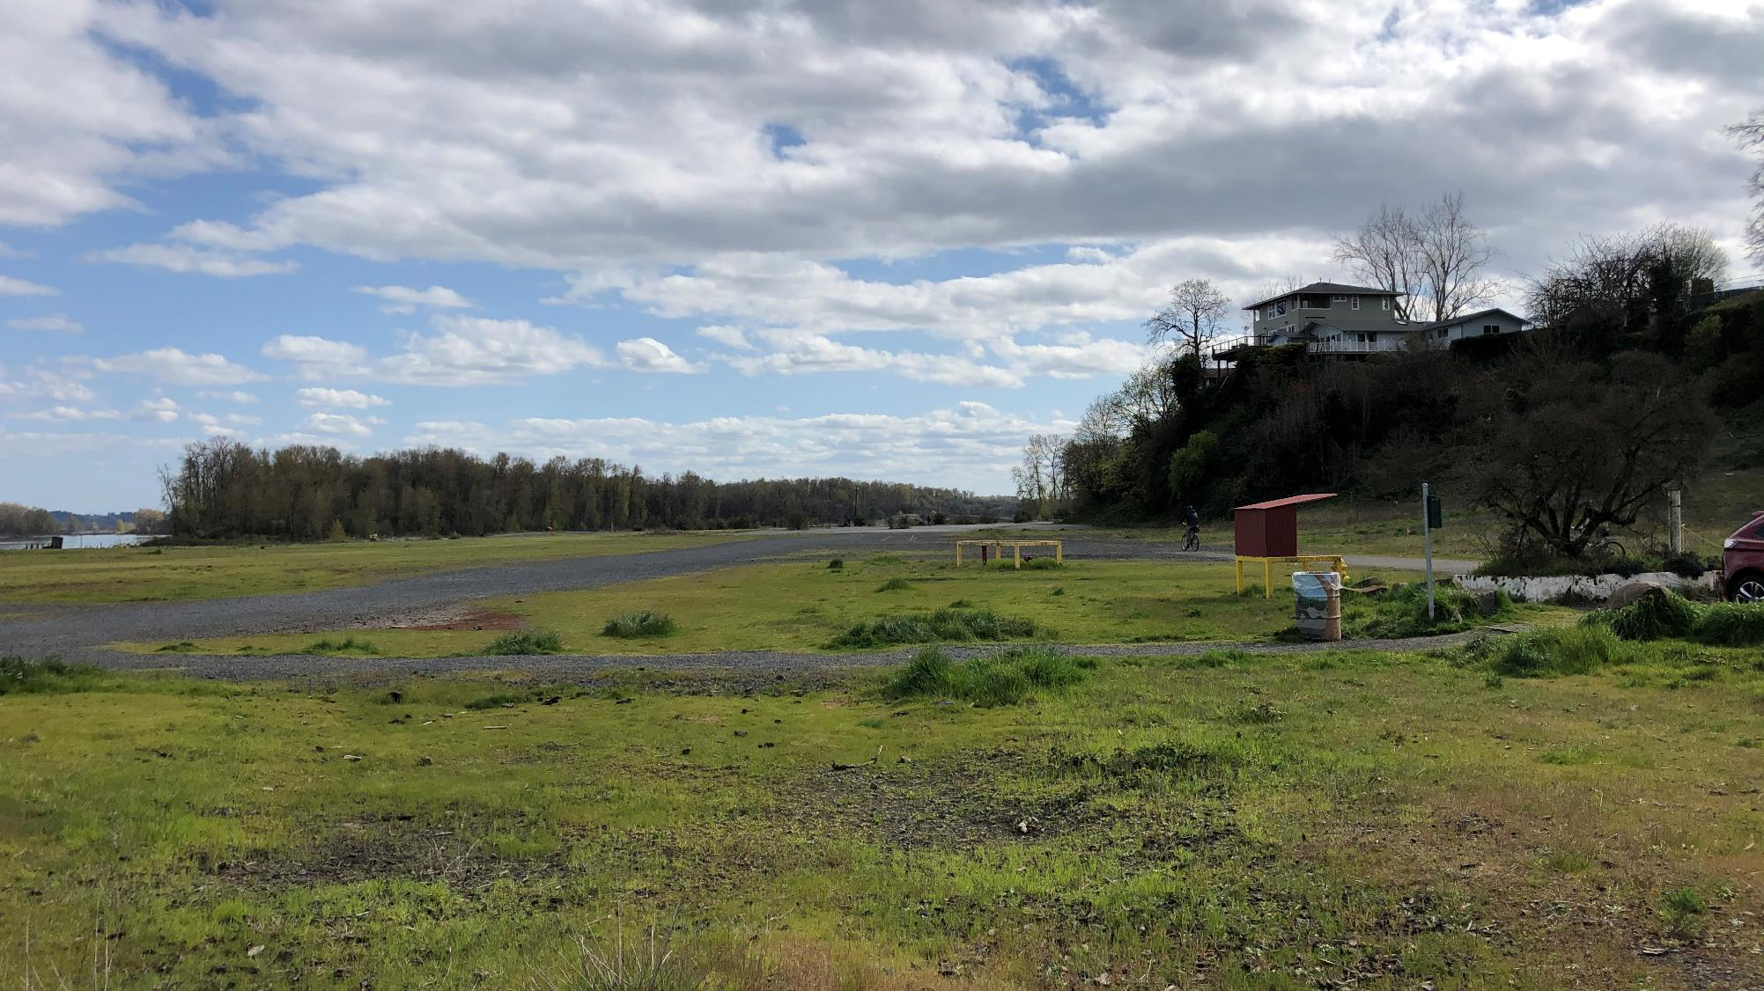
Accessing the Funding

Slide 15
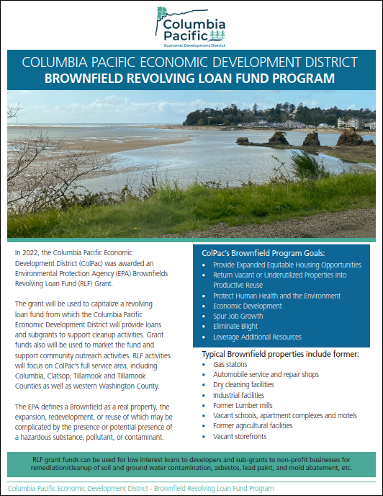
The Basics
Funding Available Now
Resources:
RLF Fact Sheet (available here)
RLF Flow Chart (available here)
RLF Applicant Guidance Manual (in review – available soon)
Low Interest Loans for Cleanup (developer)
Subgrant for Cleanup (municipalities and non-profits)
Supplemental Funds available annually with demonstrated momentum
RLF Performance period can extend to 15 yrs
15

Slide 16
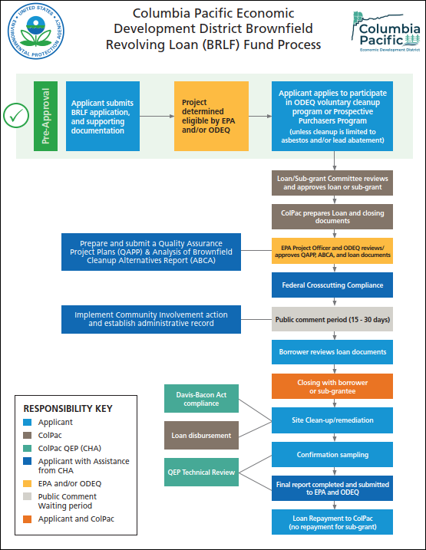
Accessing the Funding
16

Slide 17
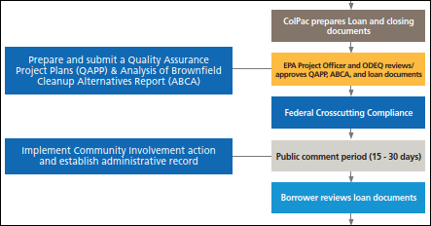
Accessing the Funding
17

Slide 18
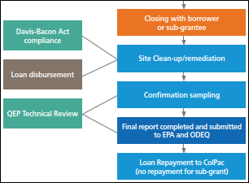
Accessing the Funding
18

Slide 19
Accessing the Funding
Stay in touch and feel free to reach out any time to vet projects
RLF Application Forms are available
Reach out any time with questions!
19

Slide 20
Case Studies

Slide 21
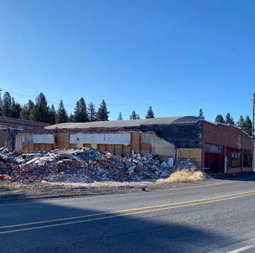
Chiloquin’s Brownfield Program
Since 2021, The City of Chiloquin has leveraged >$980,000 in State and Federal Brownfield Program funding
2021 Business Oregon Assessment Grant for the pre-acquisition due diligence for the former Markwardt Brothers Garage site$56,000)
FY2021 EPA Community-wide Assessment Grant ($300,000)
FY2022 EPA Cleanup Grant for the former Markwardt Brothers garage ($402,500)
2023 Business Oregon Cleanup Grants for removal of Chiloquin Mercantile Building asbestos-containing debris ($220,000)
21

Slide 22
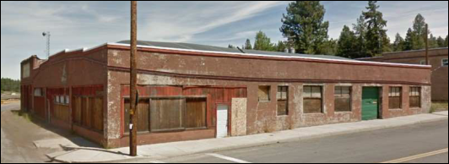
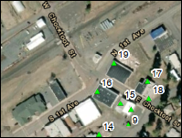
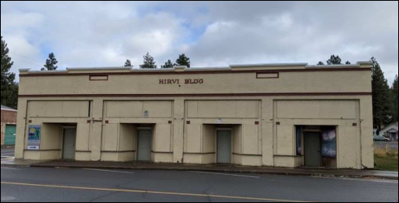
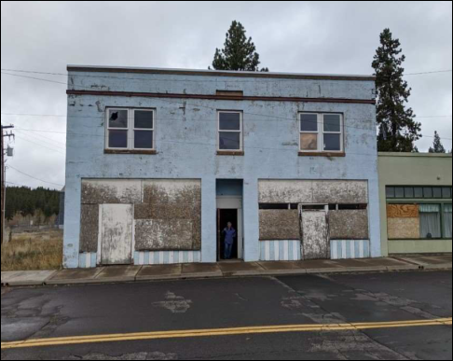
Chiloquin’s By the Numbers
Incorporated 1926
Population 767
0.82 Square miles
Grant funded Development Opportunity inventory identified 21 Brownfields
19
Development
Opportunity
Inventory
17
16
22

Slide 23
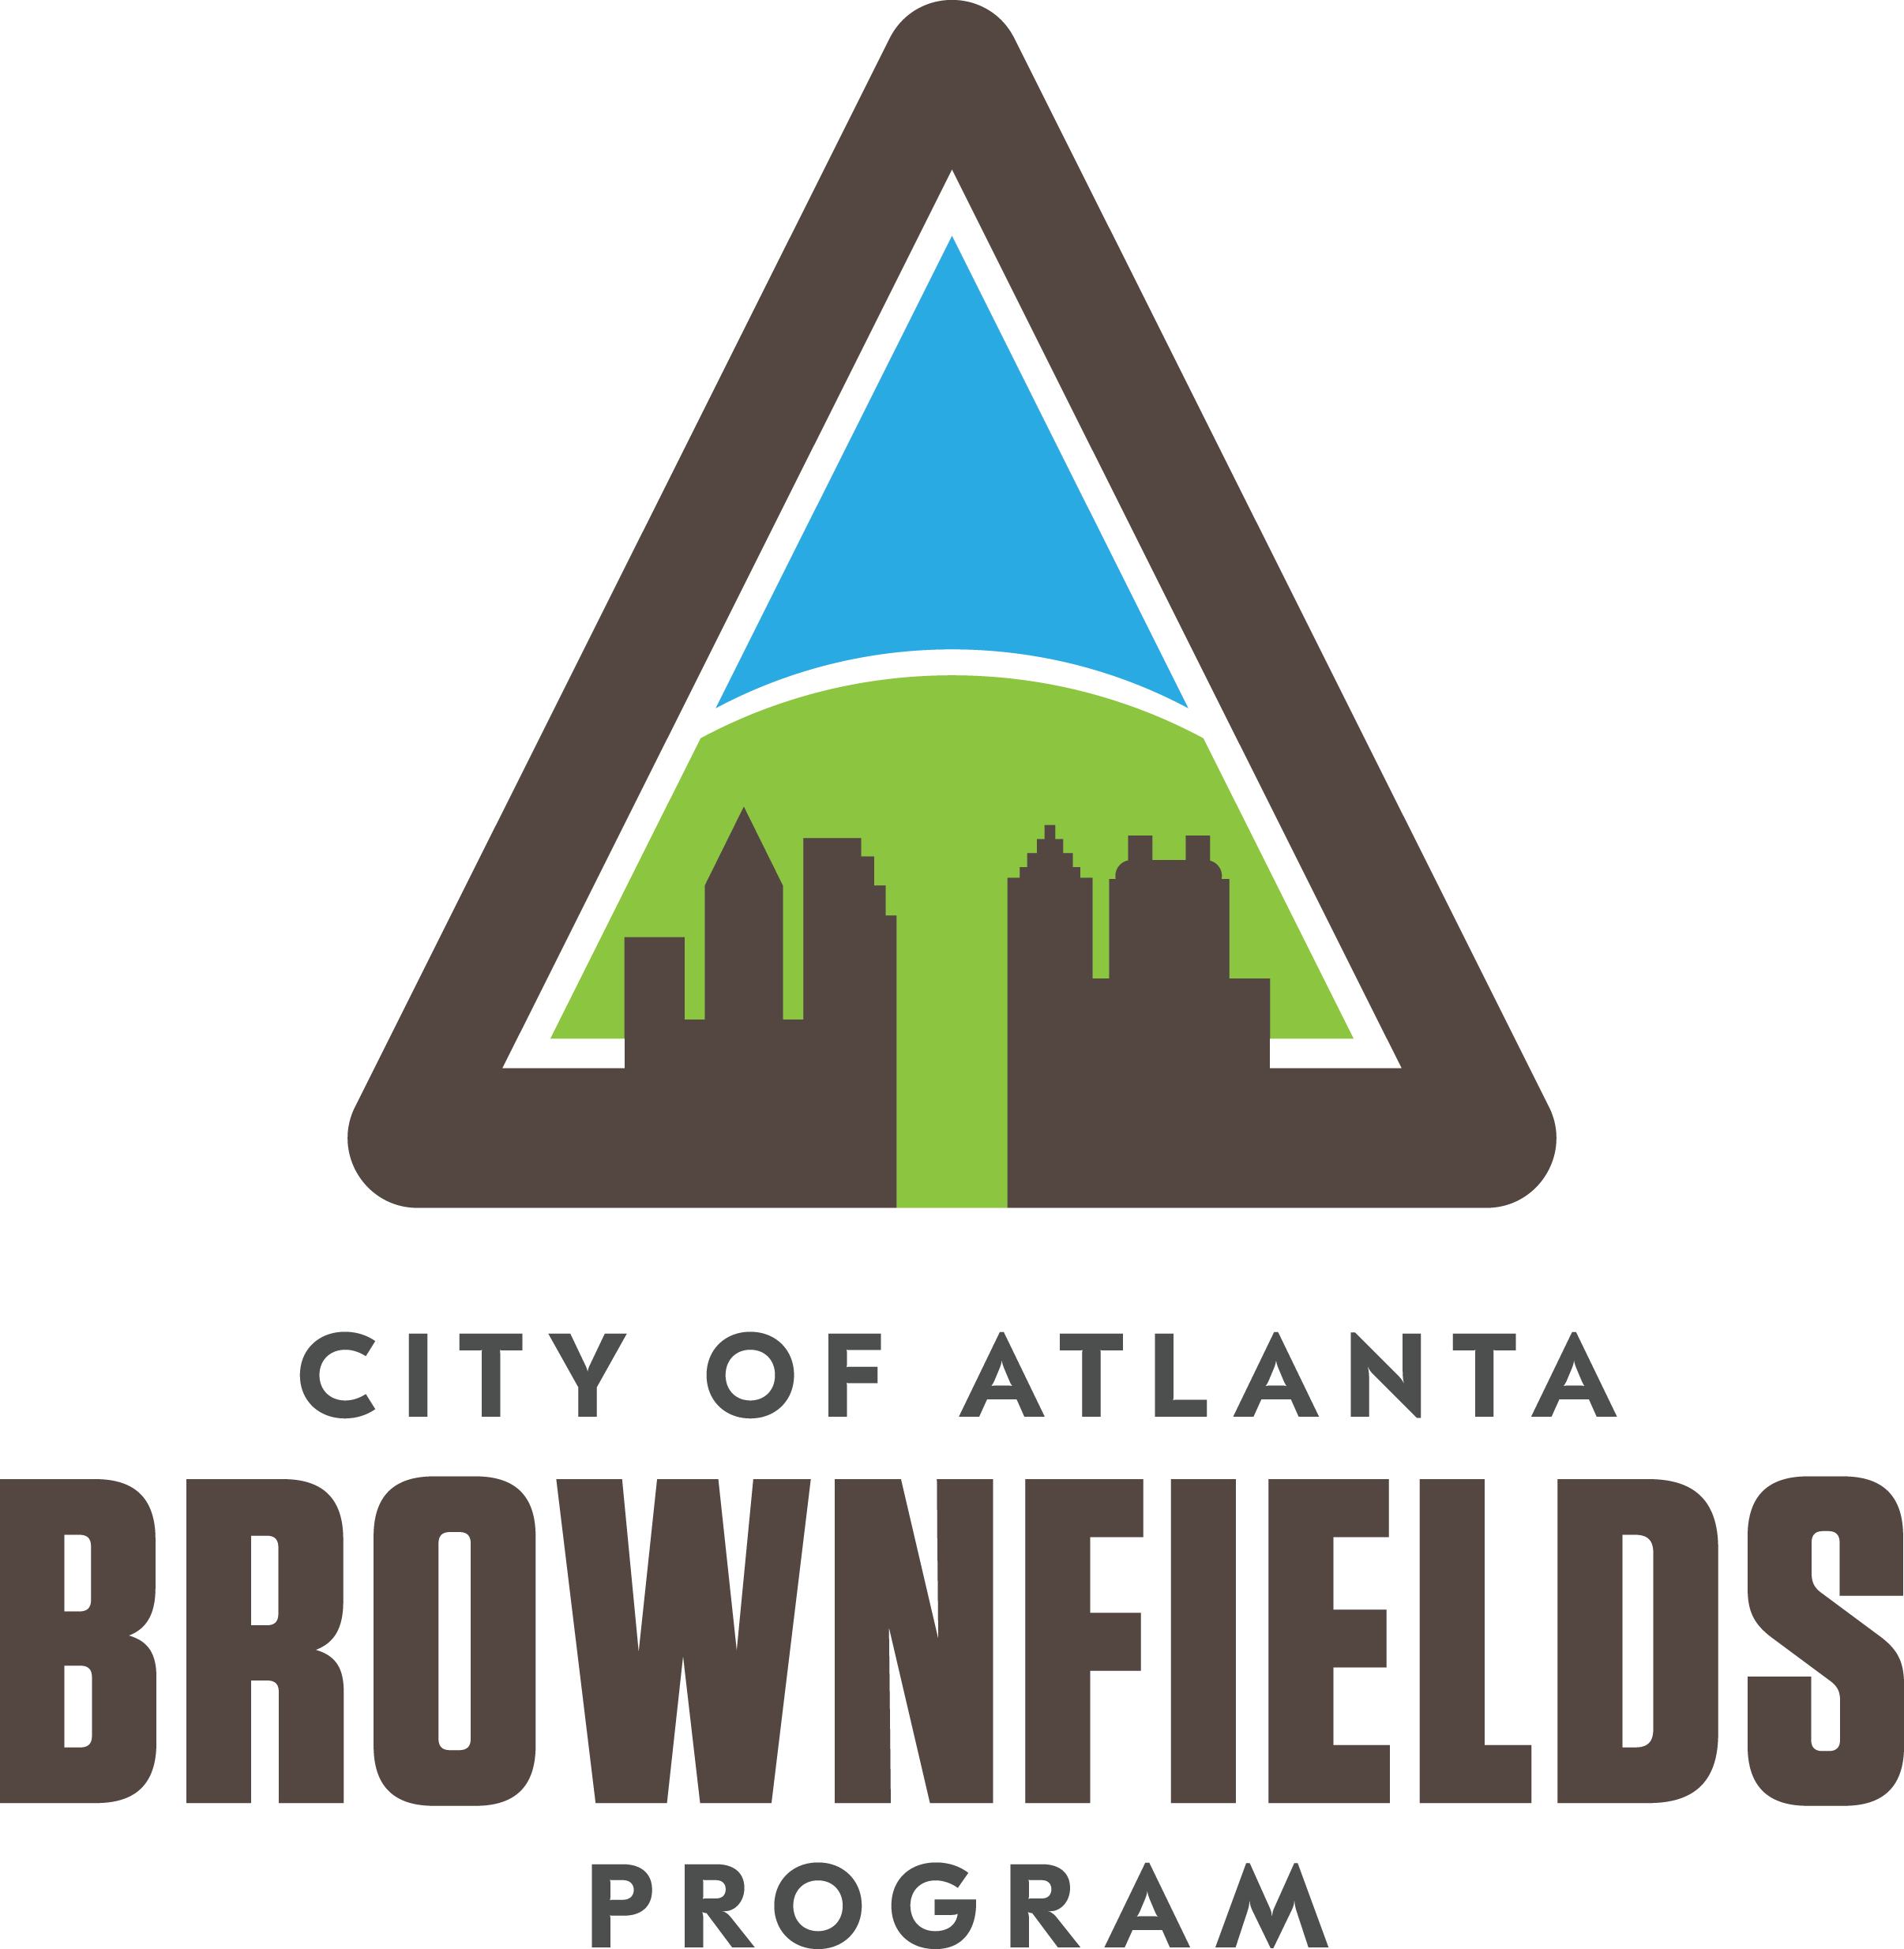
Pullman Yard Transformed
26.8 acres/>12 buildings
Built from 1900s to 1950s
1,212 to 70,656 sq ft in size- 153,000 sq ft
Pratt Engineering- tested chemical process equipment 1904-1926
Pullman Company- rail car maintenance 1926- 1950s
Second American Iron-metal manufacturing- 1955- 1965
Southern Iron and Equipment - rail car manufacturing- 1965-1980
Georgia Building Authority

Slide 24
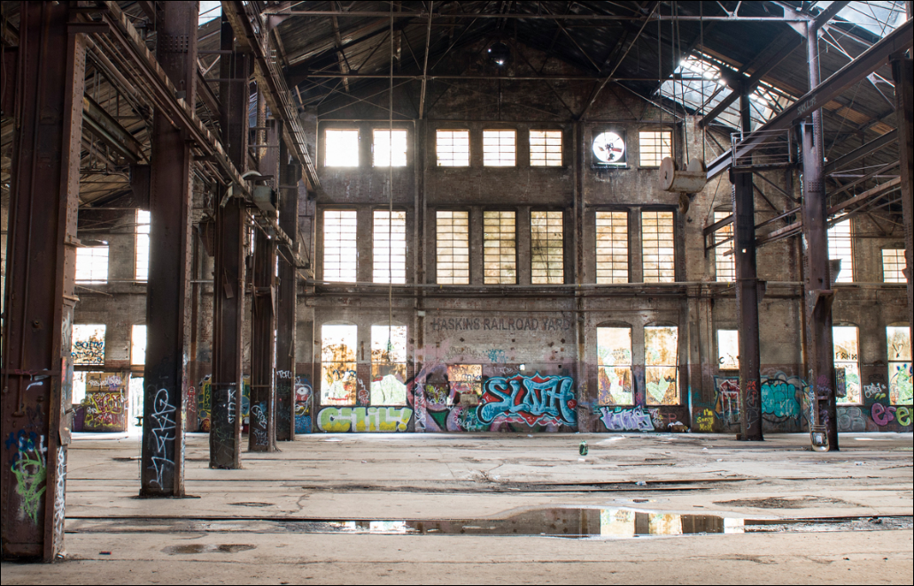
Pullman Yard Transformed
Atomic Entertainment Purchased Site in 2018
Multiple EPA Grants Leveraged
Cleanup planning completed under City of Atlanta Assessment Grant (2019) (~$40,000.00)
FY2009 City of Atlanta RLF Loan funded Asbestos Abatement in 6 buildings (~$1 Million)
FY2011 Decide DeKalb RLF Funded ~3000 cy impacted Soil Removal & Disposal (~1 Million)
FY2022 City of Atlanta RLF to fund additional soil remediation(~1 Million)

Slide 25
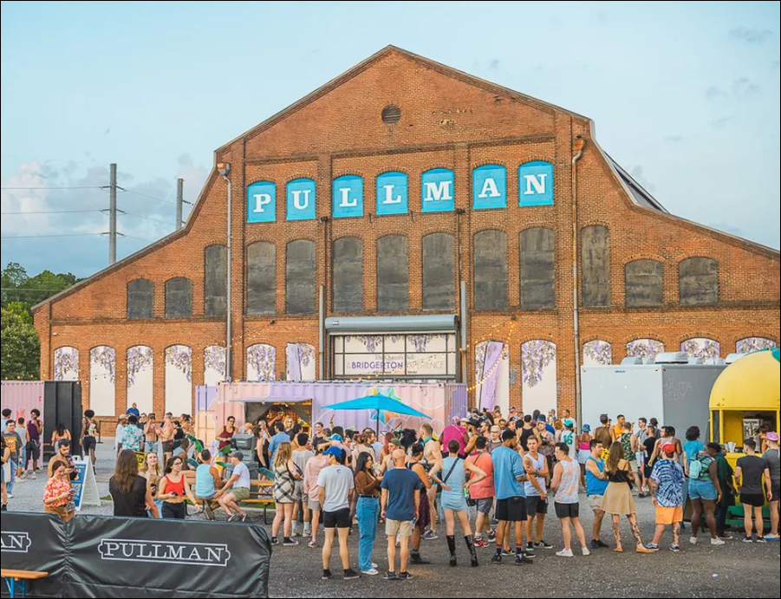
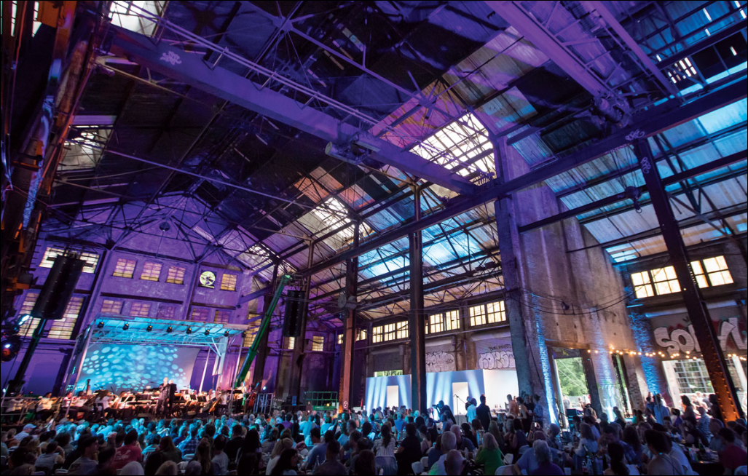
Pullman Yards Today
25

Slide 26
Thank you/Questions
For more information, please contact:
Sarah Lu Heath
Deputy Director, ColPac EDD
p. 971.328.2877 | e. SarahLu@nworegon.org
Keith J. Ziobron, PE
CHA | Associate Vice President - Brownfield Program Discipline Lead
p. 678.787.9576 | e. kziobron@chacompanies.com

